Slide 1
FARMERS’ MARKET NUTRITION PROGRAM OVERVIEW AND UPDATES
Christina Iliev, FMNP Assistant Coordinator

Slide 2
Farmers’ Market Nutrition Program (FMNP)
Funded by Federal and State governments
Administered by the Minnesota Department of Agriculture
Serves Dual Purposes
To provide fresh, unprepared, locally grown fruits, vegetables, and herbs to WIC participants and Seniors
To expand the awareness, use of, and sales at farmers’ markets
Program dates June 15 - October 31

Slide 3
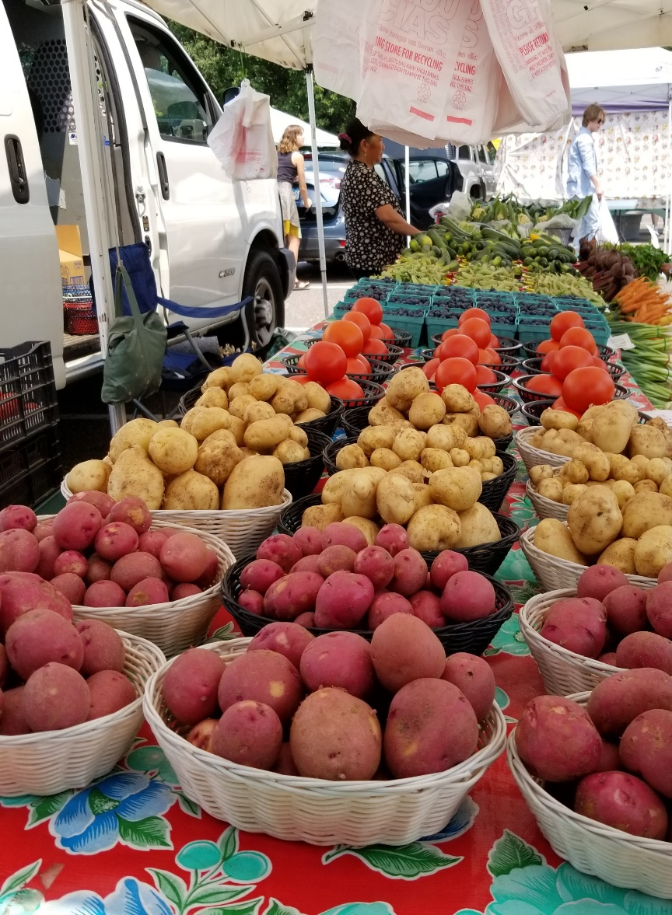
How does the program work?
WIC Clinics + Participants
Senior CSFP Sites + Participants
Farmers’ Market Managers
Farmers’ Market Vendors
Photo Credit: Minnetonka Farmers’ Market

Slide 4
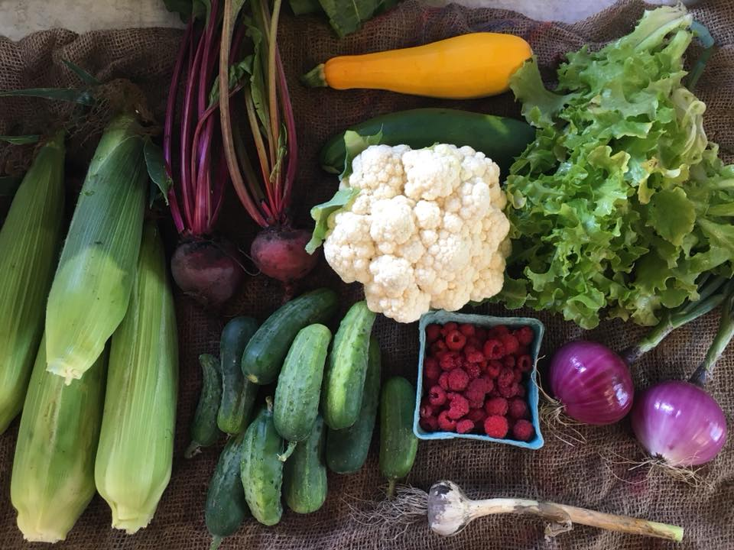
Eligible Food Items
Participants may purchase foods that meet all the following criteria:
Fresh
Unprepared/unprocessed
Locally grown
Fruits, vegetables, or cut herbs
Photo Credit: Thompson Produce

Slide 5
Eligible WIC + Senior Participants
WIC Households ($30)
Pregnant Women
Breastfeeding and Postpartum Women
Children up to age 5
Seniors over age 60 ($50)
Eligible for the Commodity Supplemental Food Program (CSFP)

Slide 6
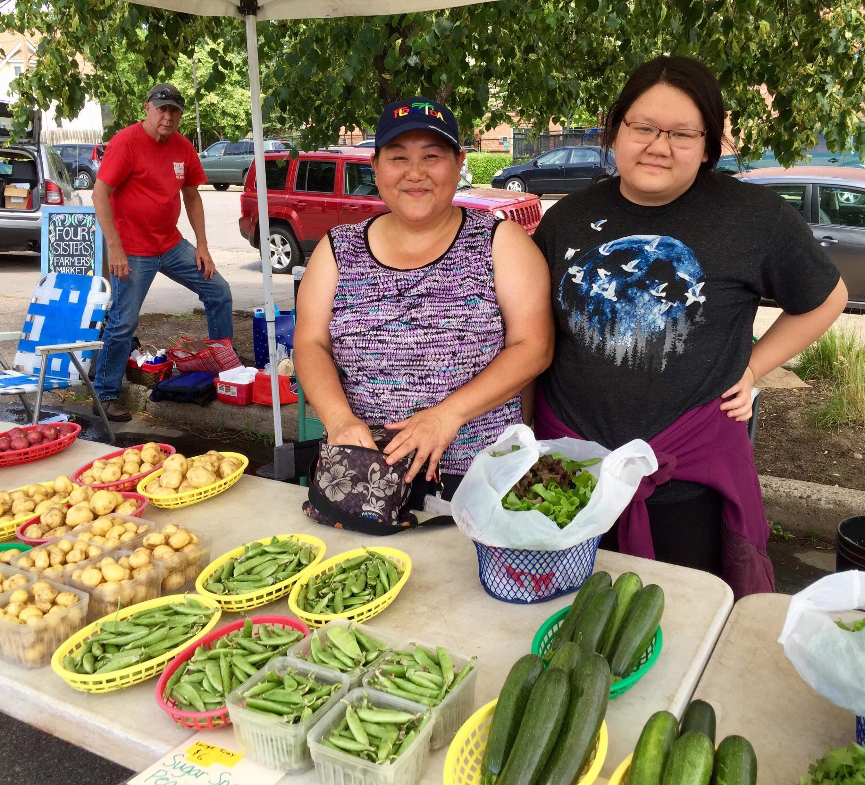
Farmers' Markets Eligibility Requirements
Established days and hours
At least three authorized FMNP vendors
Established market rules or by-laws
No fee for members to participate in FMNP
At least one successful summer of operation prior to authorization
Markets must renewal annually
Photo Credit: Four Sisters Farmers’ Market

Slide 7
Vendor Eligibility Requirements
Grow the items that you sell
Sell fresh, unprocessed fruits, vegetables, or herbs
Sell your items at an authorized farmers’ market
Be a resident of Minnesota or a neighboring state
Vendors must renew annually

Slide 8
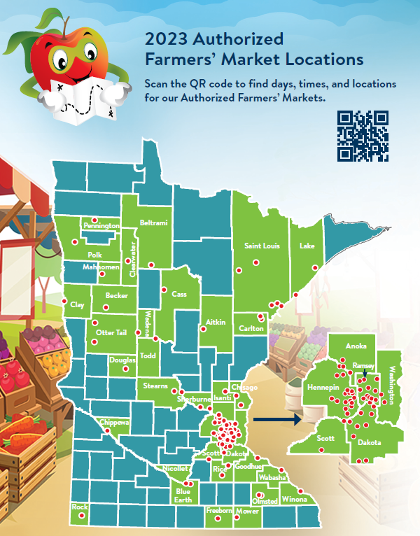
2023 FMNP Season in Review
106,313 WIC and Senior checks were deposited by vendors totaling $531,565 (20k more checks than last year totaling 100k)
427 authorized vendors (55 more than last year and our highest # to date)
28 WIC partner agencies (increased by 4)
5 Senior partner agencies (decreased by 1)
82 Authorized Farmers’ Markets (22 more than last year and our highest # to date)
2023 Authorized Farmers’ Markets

Slide 9
Farmers’ Market Nutrition Program 2024
Modernization of the Farmers’ Market Nutrition Program (FMNP) is happening nationally. We’re moving away from paper and towards electronic management.
Upcoming December Newsletter Highlights:
Modernization is coming! Take a brief survey so we can gauge your technology needs and access points before moving Minnesota’s program to an electronic solution.
Authorization will take place early in 2024! Look for emails and letters in February.
Training will be mandatory for all vendors and market managers and will take place in March and April.

Slide 11
Thank you!
Emily Mehr
Program Coordinator
651-201-6456
emily.mehr@state.mn.us
Christina Iliev
Assistant Program Coordinator
651-201-6494
christina.iliev@state.mn.us
https://www.mda.state.mn.us/food-feed/seniorfarmers-market-nutrition-program

