Slide 1
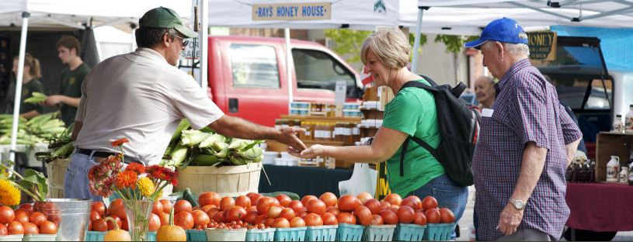
SNAP/EBT at Farmers Markets

Slide 2
Market Bucks
Market Bucks is a farmers market incentive program designed to help SNAP customers increase their purchasing power at farmers markets.
SNAP customers can use their EBT card at 99 participating farmers market locations and receive a dollar-for-dollar match on all SNAP spending at the market, up to $10.

Slide 3
Year in Review 2020
SNAP customers spent $276,920 in SNAP/EBT and
$184,365 in Market Bucks during summer 2020.
Creating $619,474 in additional economic activity in communities throughout the state.

Slide 4
Market Bucks Transactions
Source: 2014-2015 data from BCBS. 2016-2020 data from Hunger Solutions.
*2016 data for May 1, 2016 to October 31,2016 as reported by participating markets. Data reflects and in match (from $5 to $10 in 2016) and incentive gift certificates.
**2017 data for May 1, 2017 to October 31, 2017 as reported by participating markets. Data reflects a decrease in number and amount of incentive gift certificates issued.
Notes:
99 participating farmers market locations reported $151,744 in Market Bucks redeemed by their vendors. This includes Market Bucks distributed as part of the dollar-for-dollar match and through the additional incentive gift certificates. Due to the popularity of the program in 2016, we limited the number of gift certificates in 2017 & 2018, which is reflected in the decrease in Market Bucks spent.

Slide 5
Market Bucks by Month
Notes:
Market Bucks redemptions grew steadily throughout the season, primarily due to:
1.) Growing awareness of the program,
2.) Increased availability of produce through the summer months, and
3.) Incentive gift certificates expiring in August and September.

Slide 6
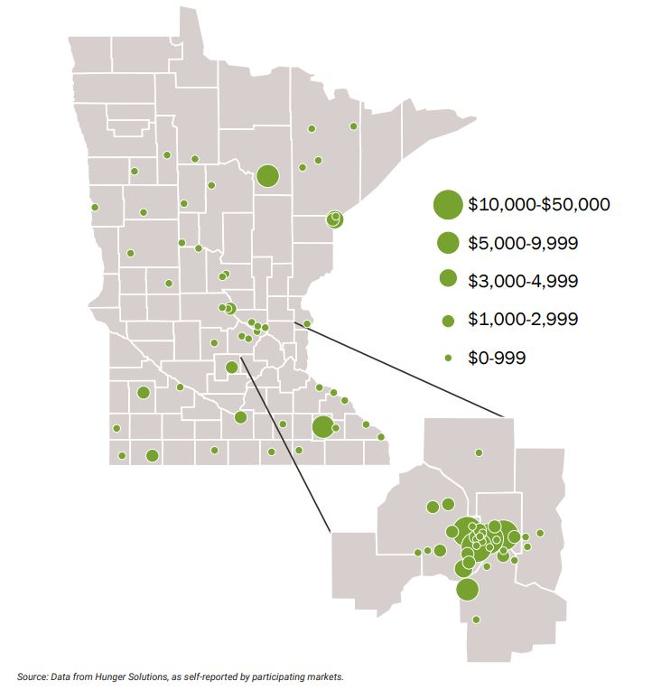
Market Bucks Redemptions by Market
Notes:
Participating farmers markets are located throughout Minnesota. Market Bucks redemptions range from $6 to just over $35,000 per market. The average was $1,932 in Market Bucks.

Slide 7
Winter Markets
November 2019-April 2020 marked the fourth full winter market season for the Market Bucks program. Markets range from one-time markets—typically at Thanksgiving or Christmas holidays—to weekly markets much like the summer schedule.
Winter 2019-2020 By the Numbers
21 $17,950 54%
participating Markets in Market Bucks spent of markets outside of the Metro

Slide 8
2019 Updates
Market Bucks secured in 2019-2020 budget
Ongoing part of the budget for $325,000/year
Administrative Grants still available through Hunger Solutions
Annual Meeting on February 6th, from 10:00am-12:00pm. Call in option available.

Slide 9
Need some resources?
Up to $500 for a card reader through SHIP
http://www.health.state.mn.us/divs/oshii/ship/communities/
No-cost one-on-one assistance for getting started
Send an email to info@snapatthemarket.com
No-cost peer-to-peer assistance for getting started and all the rest
Farmers Market Coffee and Call
2nd Wednesday of (nearly) every month at 8am
Dial 1-844-302-0362 and enter 32952809 at the prompt
Farmers Market group on MDH’s Basecamp
Contact Nicole.Chimbetete@state.mn.us to get signed up

Slide 10
Questions? Contact:
Nicole Bailey
nbailey@hungersolutions.org651-789-9851
OR
David Nicholson
david@n-node.com

