Slide 1
Market Bucks 2023 Update
Jill Westfall, Director of Programs
jwestfall@hungersolutions.org

Slide 2
Market Bucks
Market Bucks is a farmers market incentive program designed to help SNAP customers increase their purchasing power at farmers markets, increase consumption of fruits and vegetables, and reduce food insecurity.
SNAP customers can use their EBT card at 120+ participating farmers and mobile market locations and receive a two-for-one match on SNAP spending at the market on the first $10 they spend on SNAP.

Slide 3
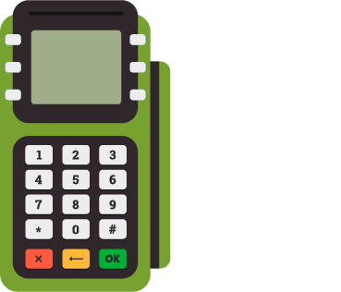
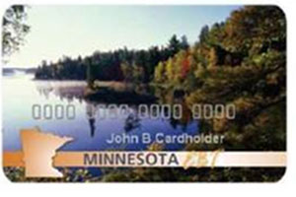
How Market Bucks work
Go to the Information Booth at the farmers market.
Swipe EBT card and spend $10.
Get $10 in free Market Bucks AND $10 in Produce Market Bucks!
(Up to $10 of each per market visit. The full amount doesn’t have to be spent each time.)
Shop for SNAP-eligible foods & produce items at the farmers market.

Slide 4
How it works
SNAP
$7
Market Bucks
$7
Produce Market Bucks
$7
Total to spend
$21
+
+
=
SNAP
$15
Market Bucks
$10
Produce Market Bucks
$10
Total to spend
$35
+
+
=

Slide 5
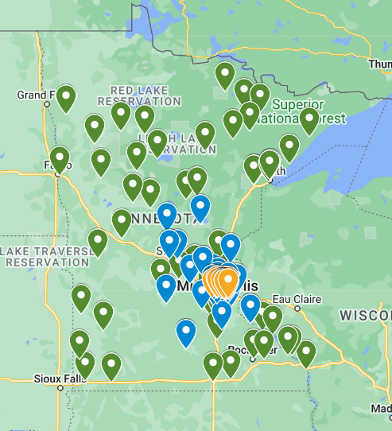
Find a market: https://www.hungersolutions.org/programs/market-bucks/

Slide 6
Market Bucks 2023
$462,567 in SNAP
$299,832 in Market Bucks
$281,040 in Produce Market Bucks
108 farmers market locations
42,929 transactions
Nearly $1 million in economic impact of the incentive spending alone

Slide 7
SNAP Redemptions

Slide 8
Market Bucks Redemptions

Slide 9
Monthly Market Bucks redemptions
*
*
* 2022 & 2023 include both Market Bucks and Produce Market Bucks redemptions

Slide 10
Coming in 2024
State appropriation increase from $325,000 to $500,000 per year
Admin grant returns (pending funding availability)
Adding Market Bucks match for direct marketing farmers including CSAs

Slide 11
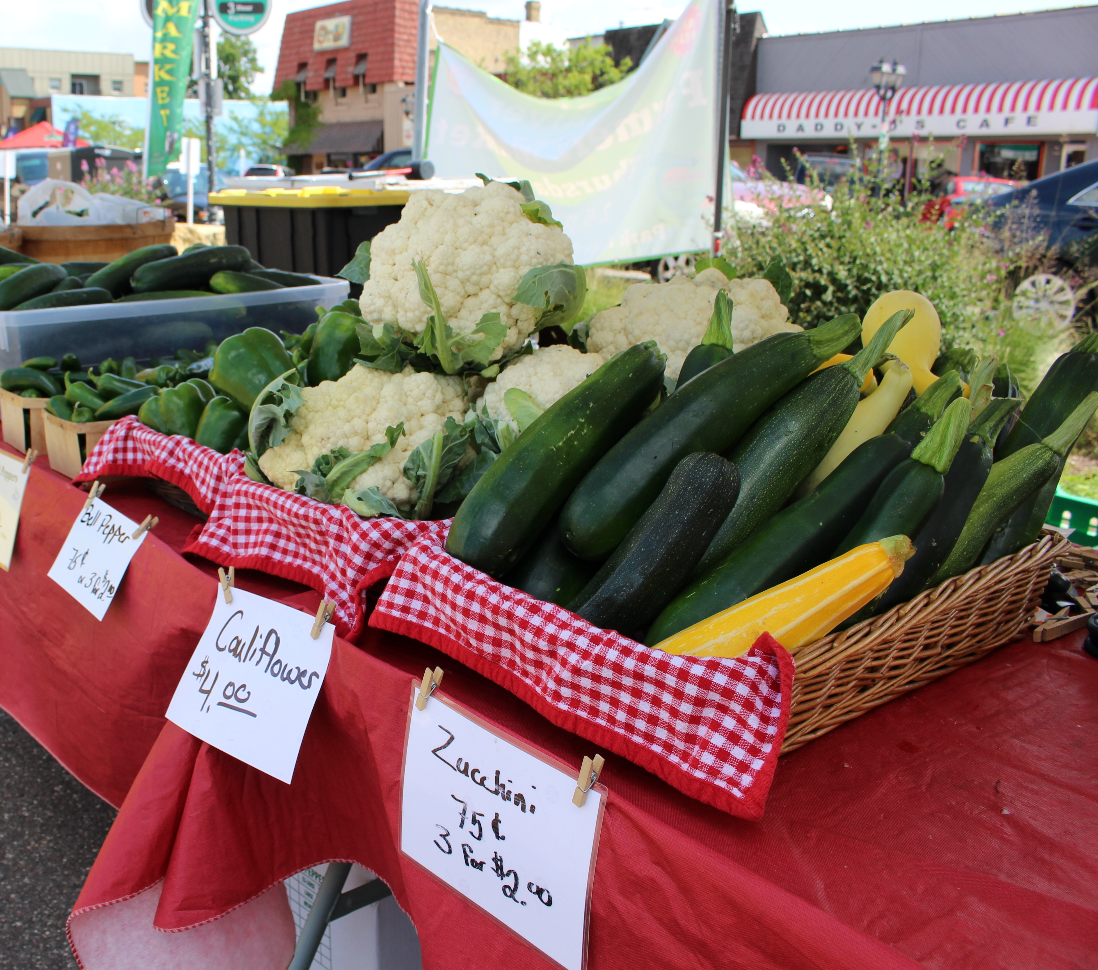
Getting signed up
Similar application for farmers markets/mobile markets and direct marketing farmers/CSAs
DMF/CSAs: Start getting SNAP authorized now
Watch for an email in late February/early March with application link

Slide 12
Contact
Jill Westfall
Director of Programs, Hunger Solutions Minnesota
jwestfall@hungersolutions.org
651-789-9843

