Slide 1
MN Farmers’ Market Academy
Onboarding Direct Marketing Farmers to Accept SNAP EBT, MB & MB Produce
Kathy Zeman
Executive Director, MN Farmers’ Market Association
info@mfma.org |https://mfma.org/Farmers-Market-Academy
January 2024
www.mfma.org

Slide 2
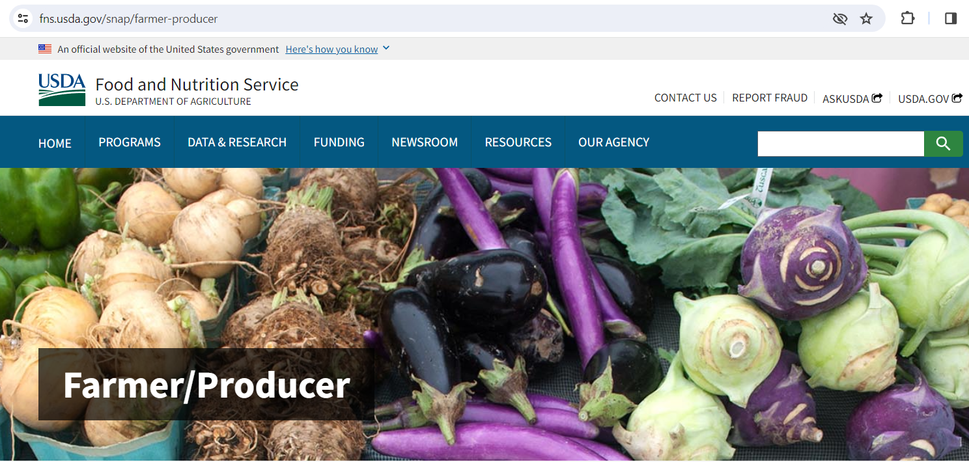

Slide 3
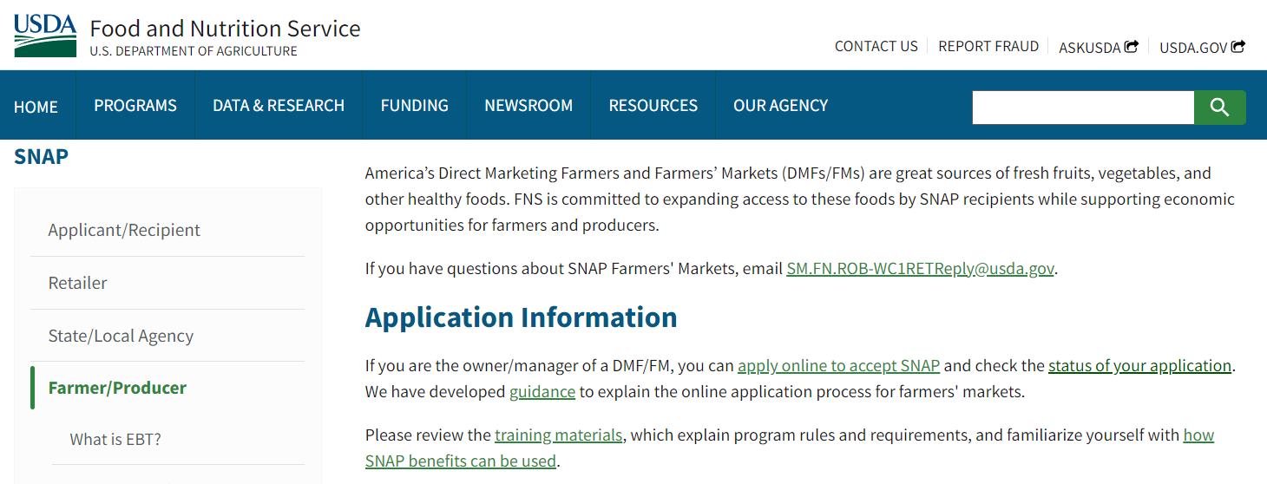

Slide 4
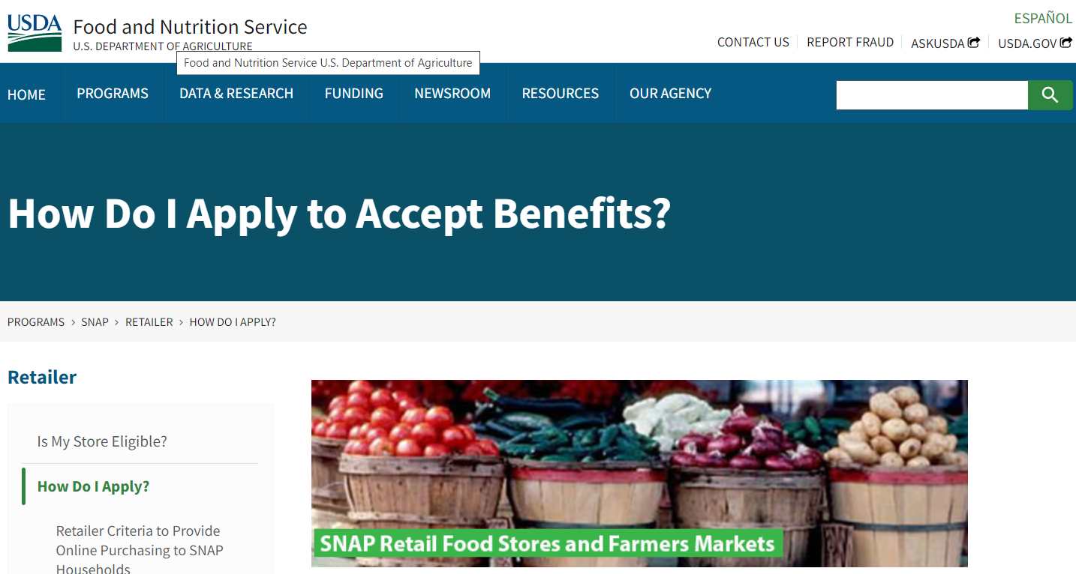

Slide 5
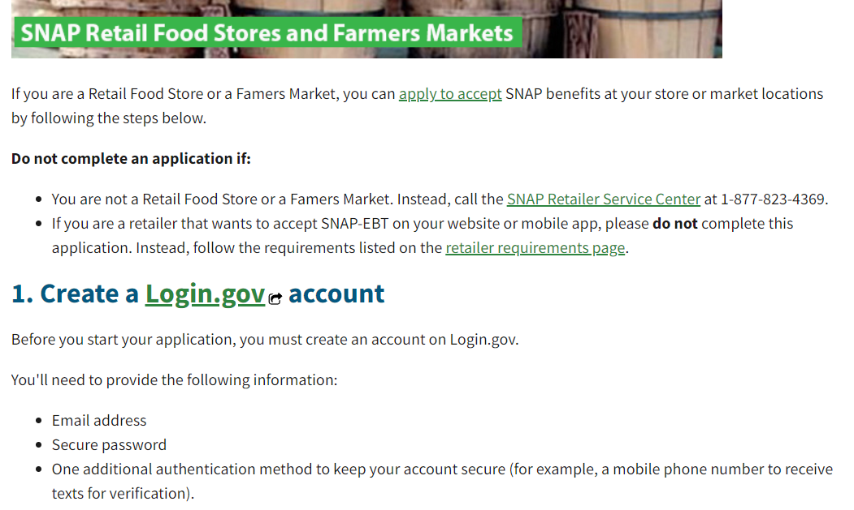

Slide 6
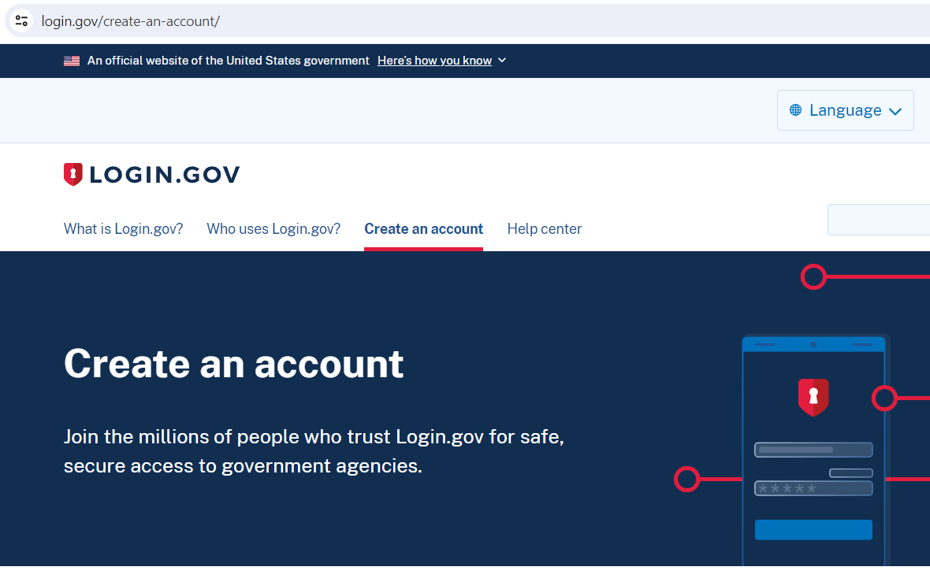

Slide 7
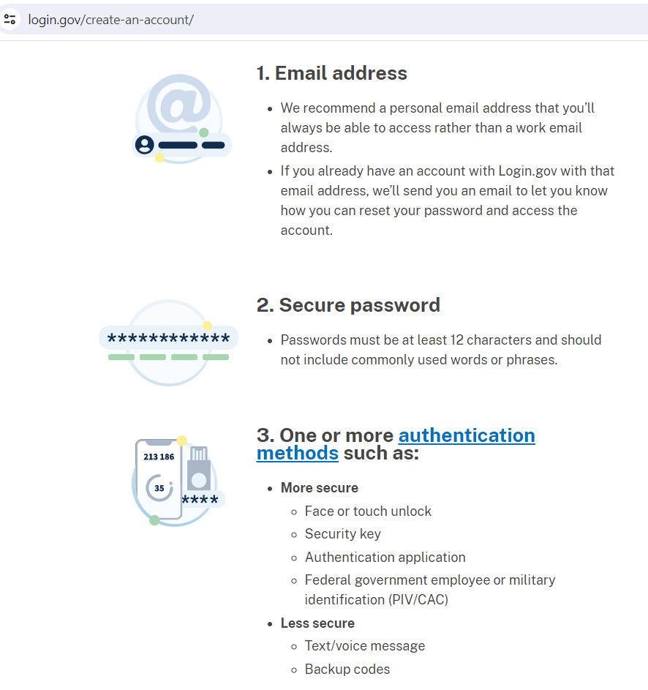

Slide 9
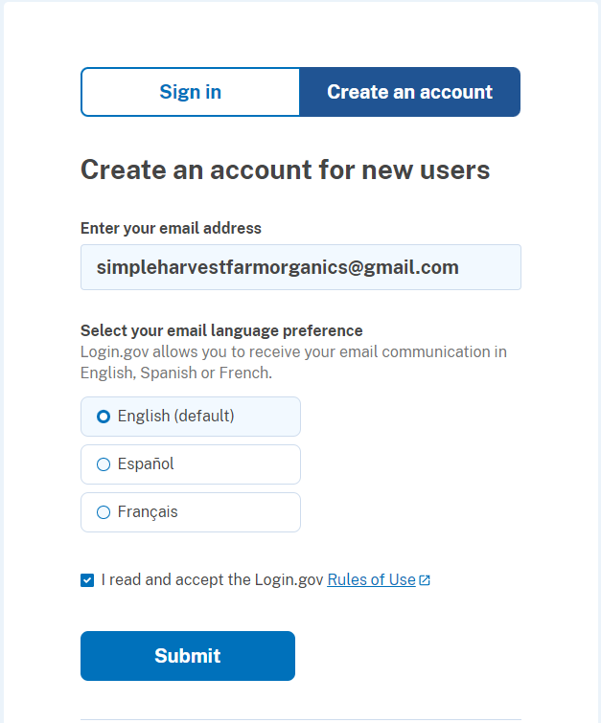

Slide 10
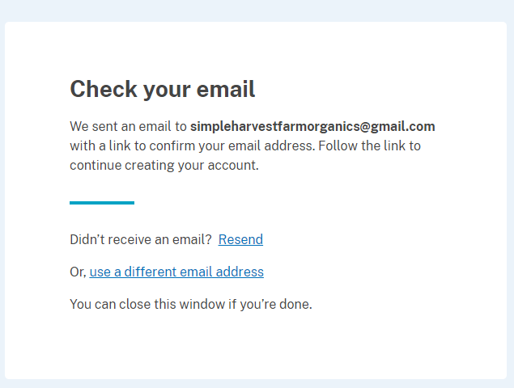

Slide 11
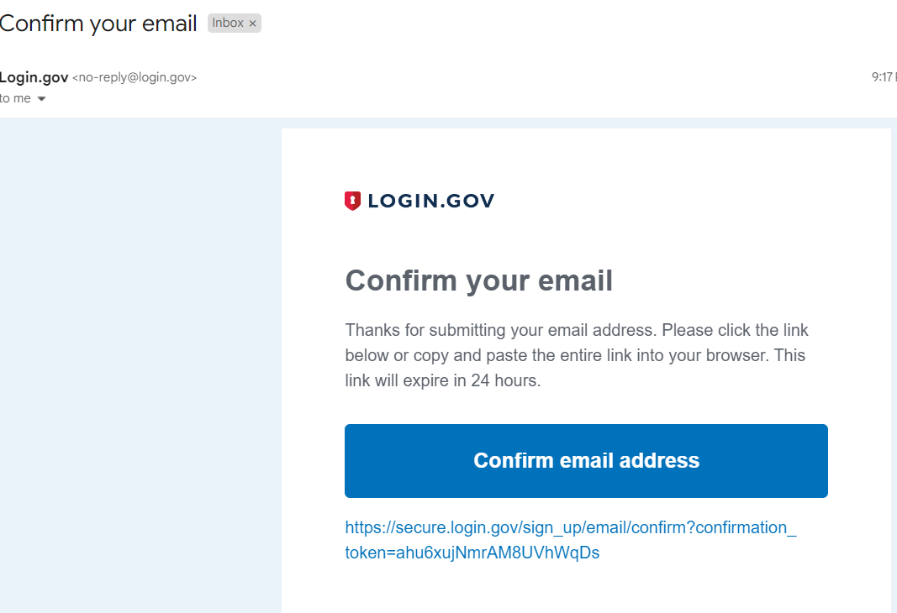

Slide 12
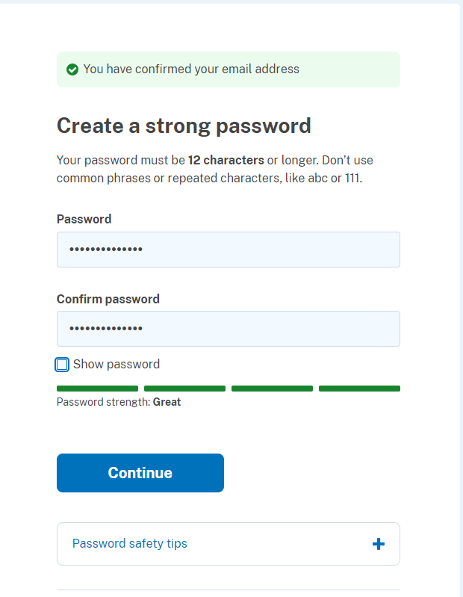

Slide 13
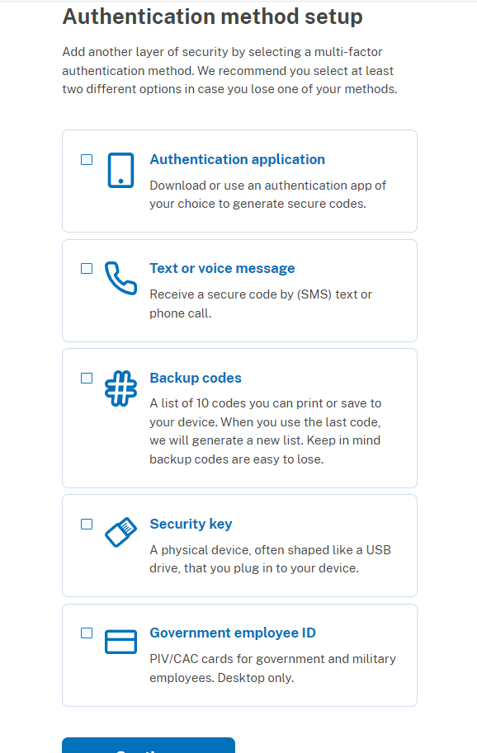

Slide 14
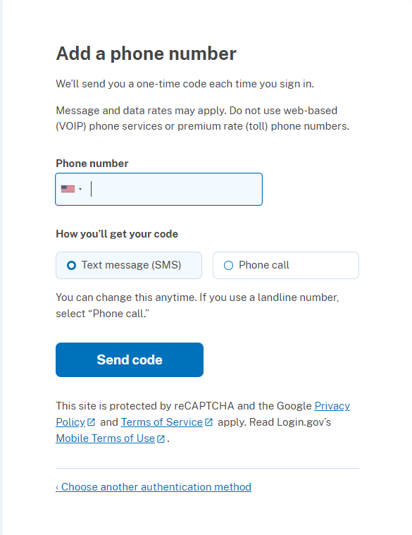

Slide 15
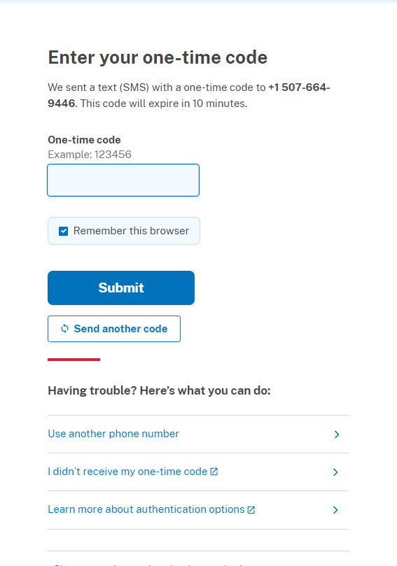

Slide 16
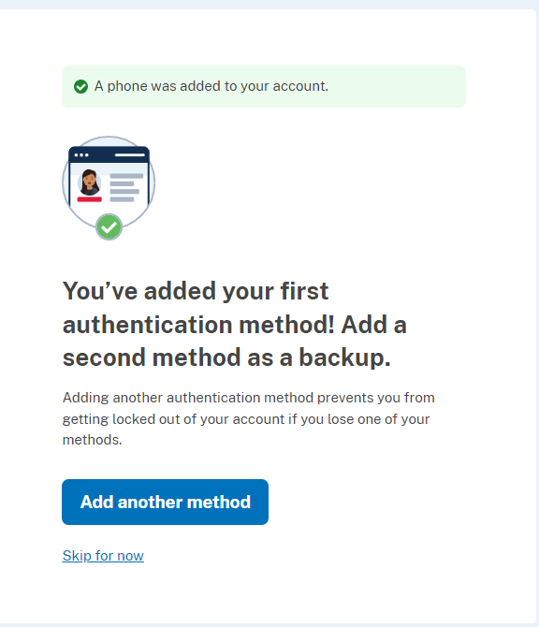

Slide 17
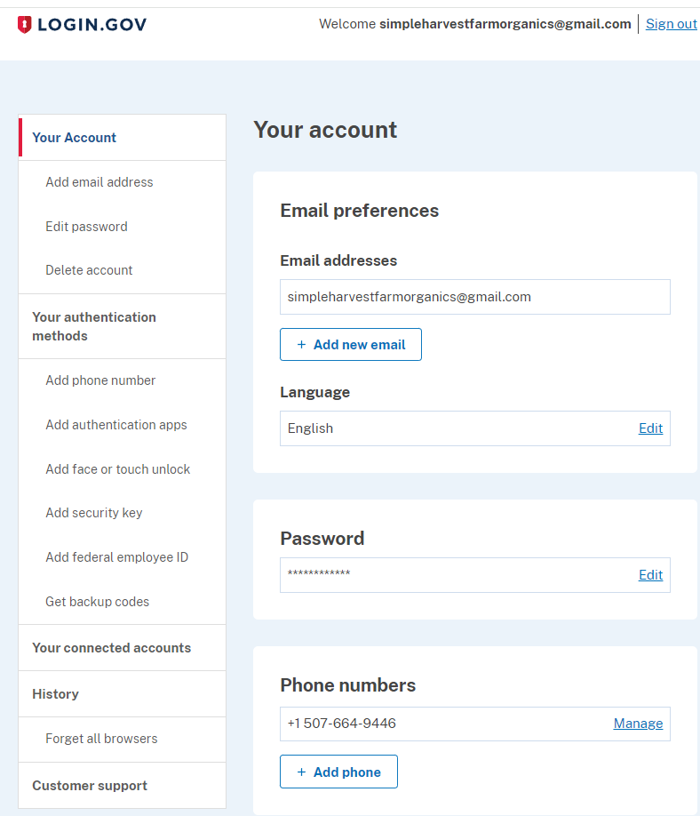

Slide 18
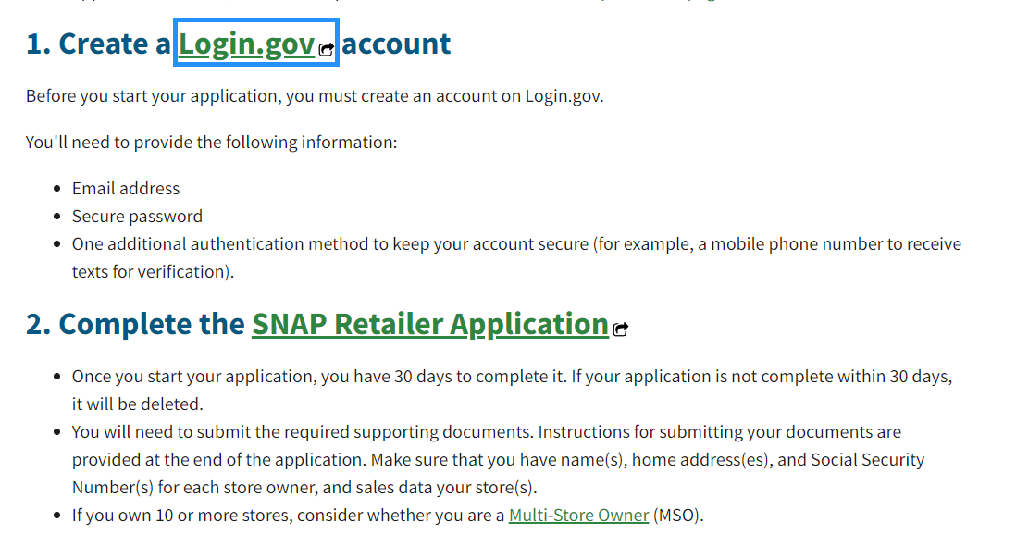

Slide 19
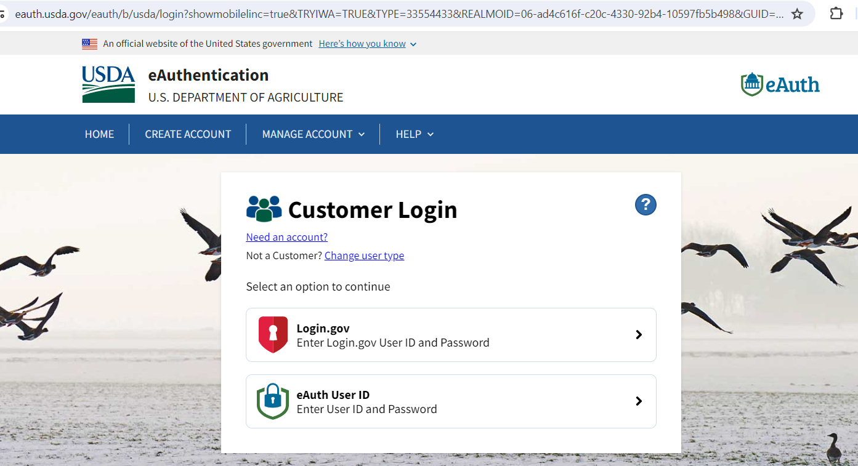

Slide 20
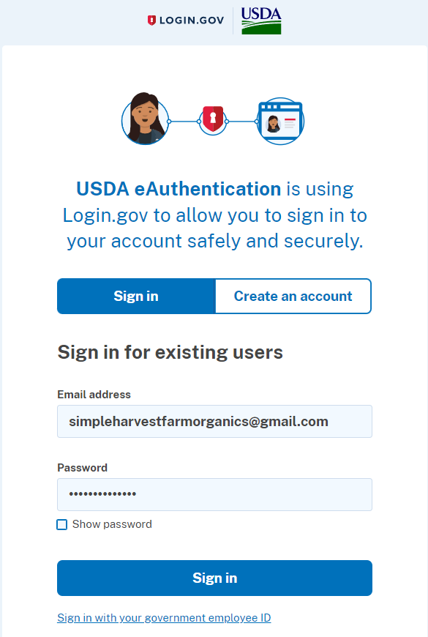

Slide 21
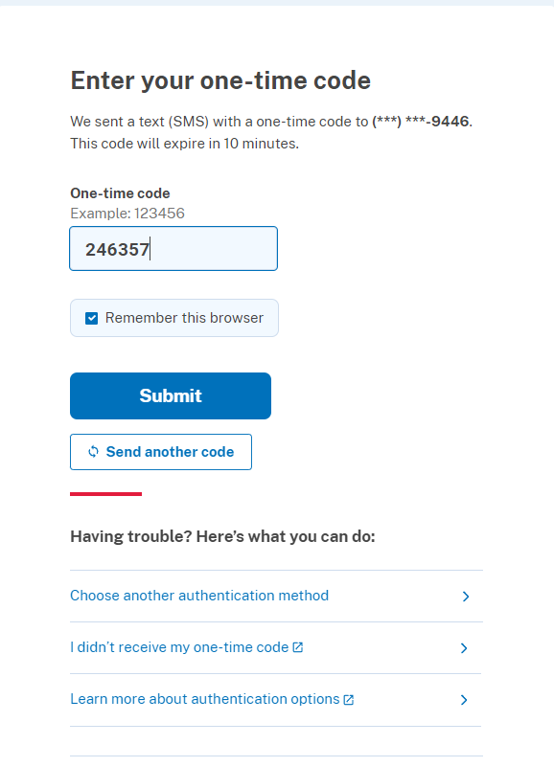

Slide 22
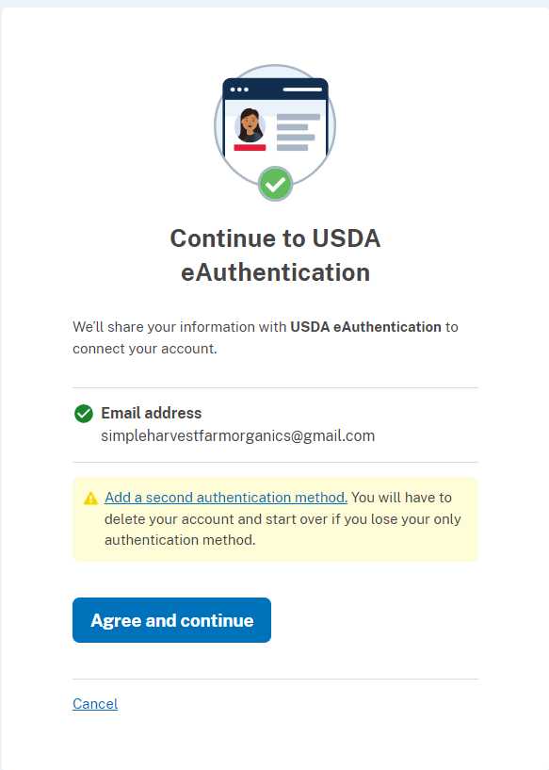

Slide 23
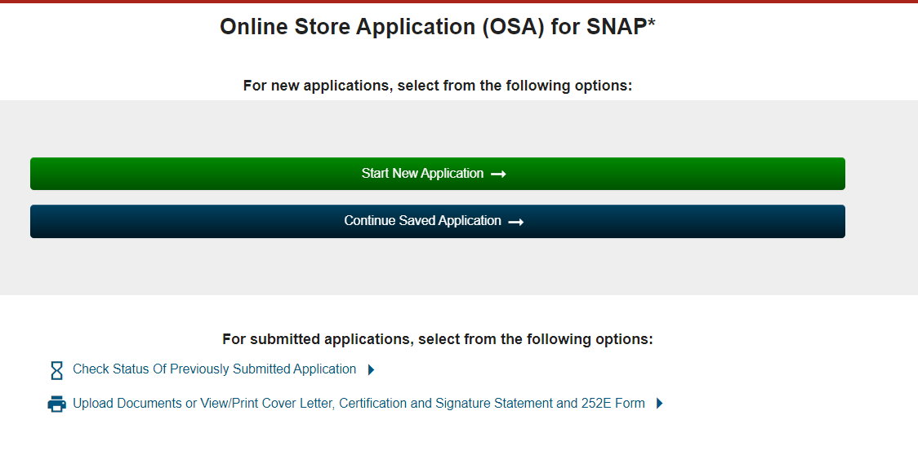

Slide 24
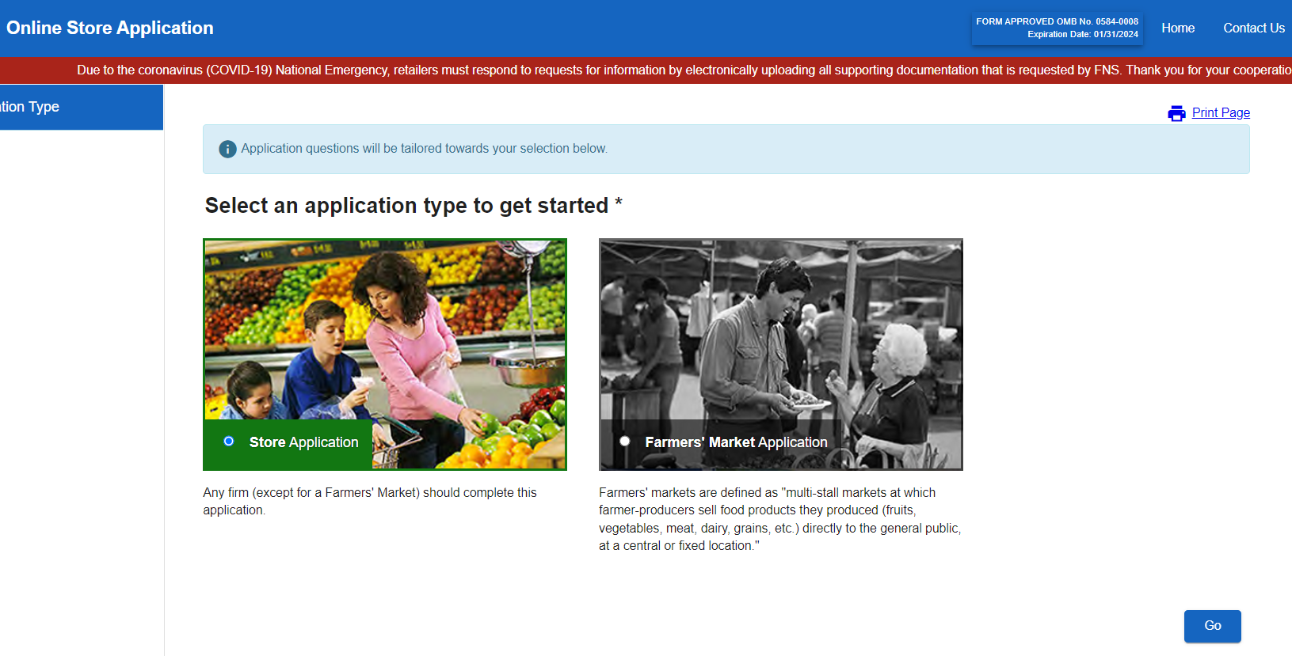

Slide 25
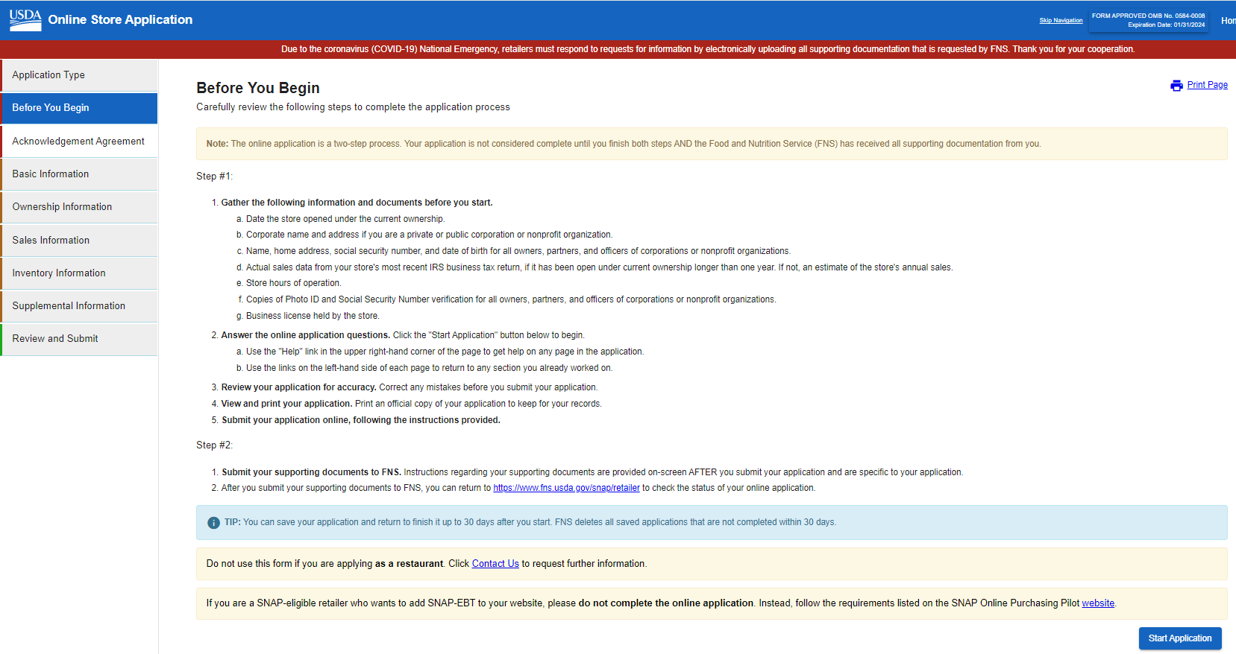

Slide 26
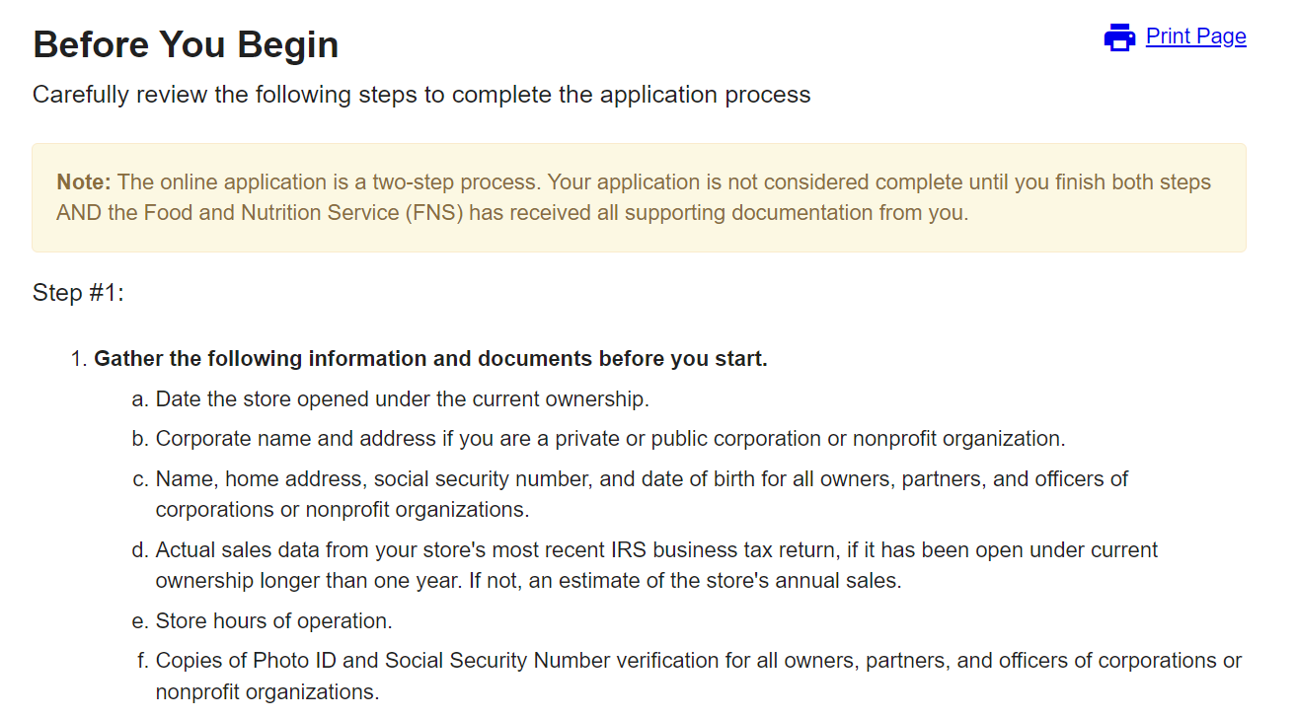

Slide 27
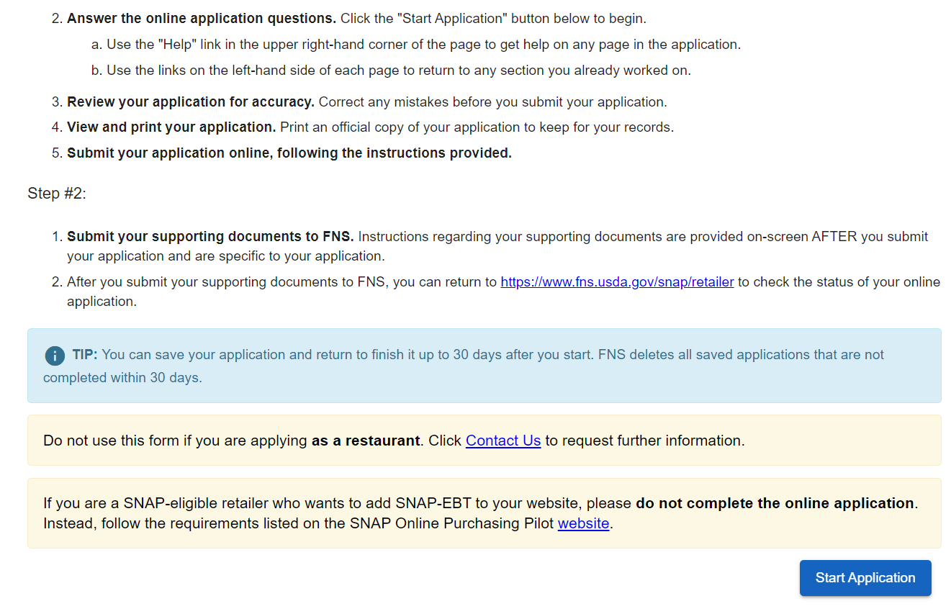

Slide 28
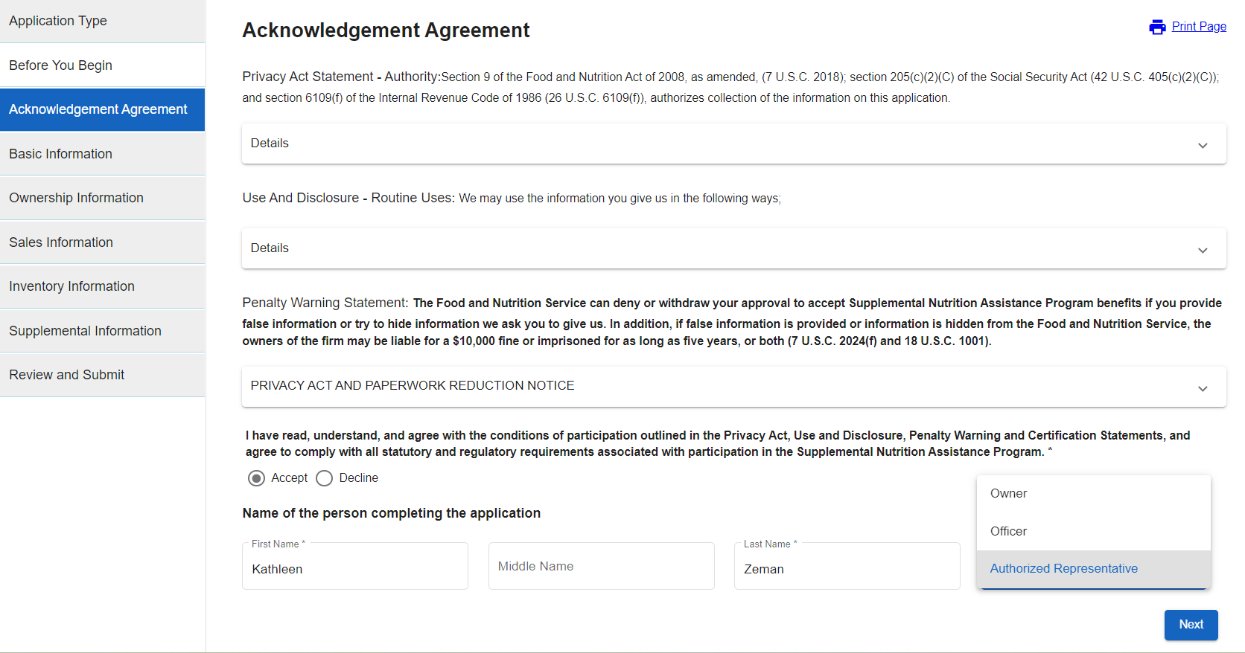

Slide 29
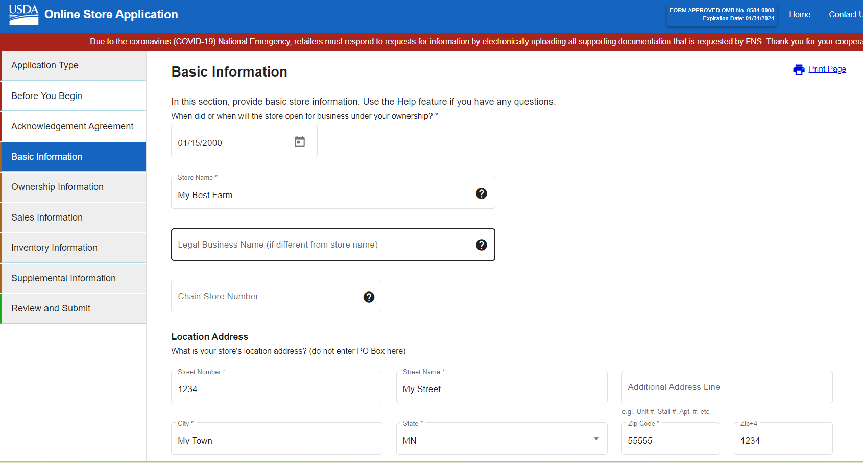

Slide 30
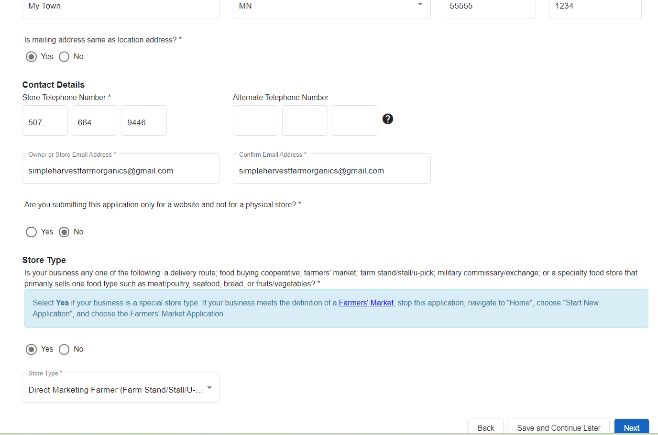

Slide 31
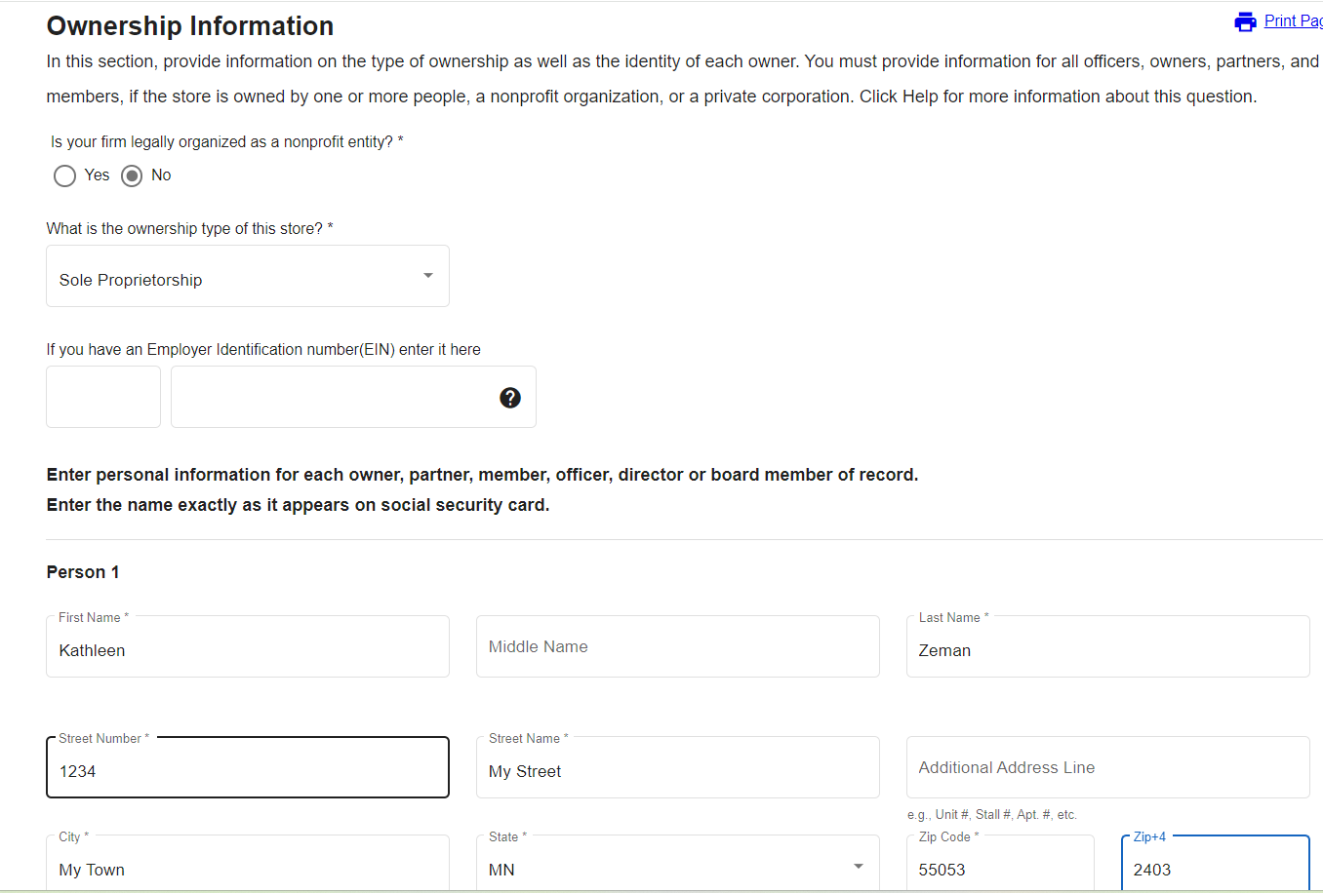

Slide 32
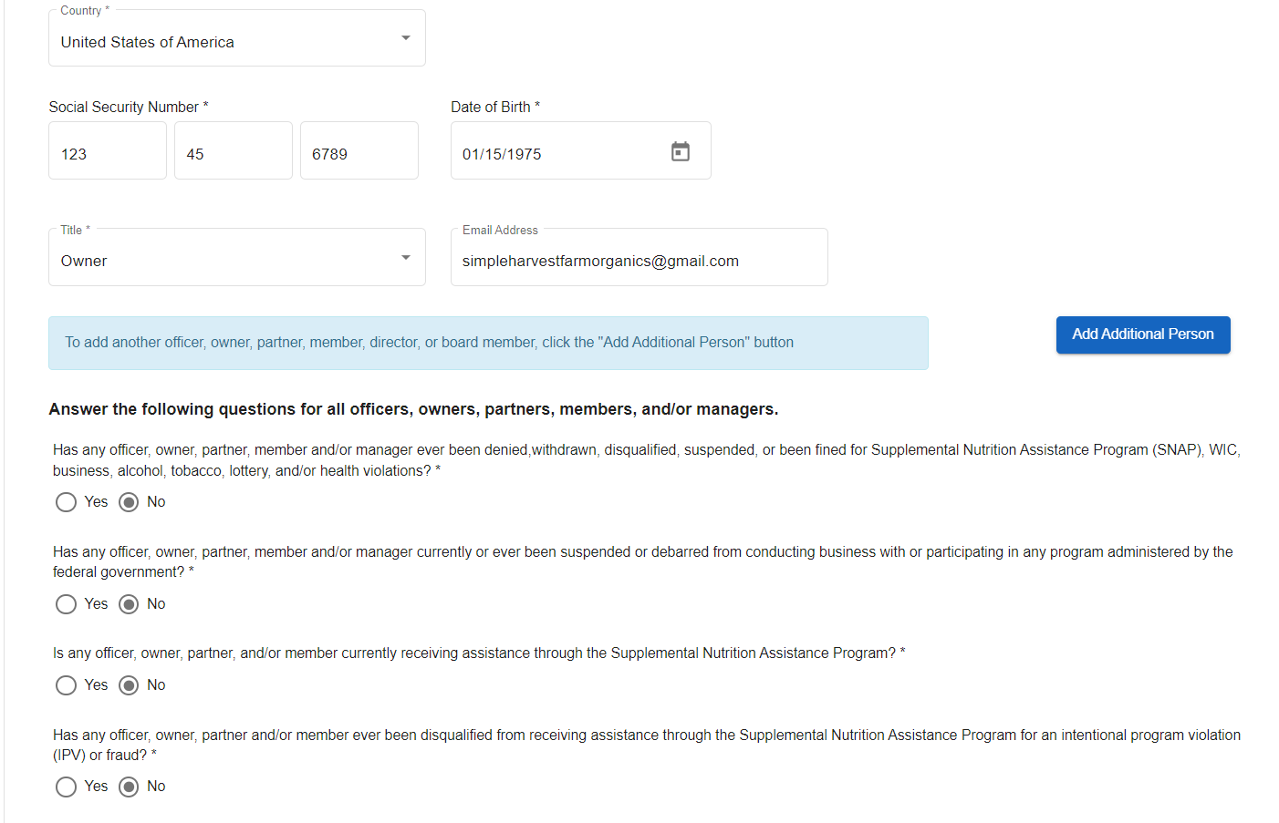

Slide 34
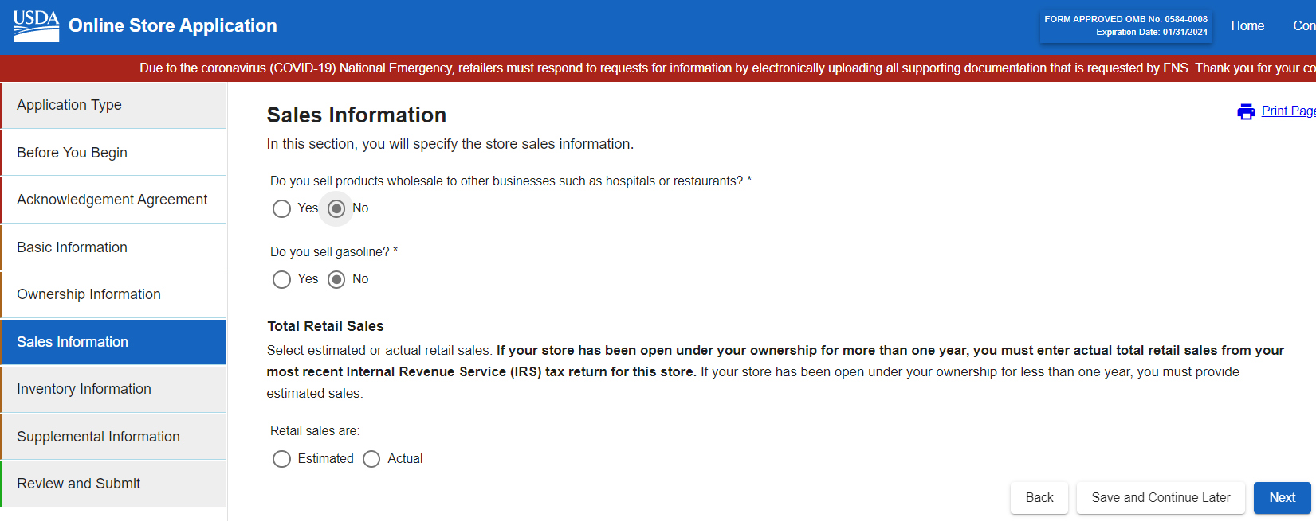
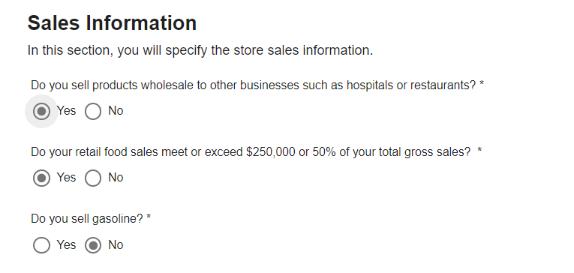

Slide 35
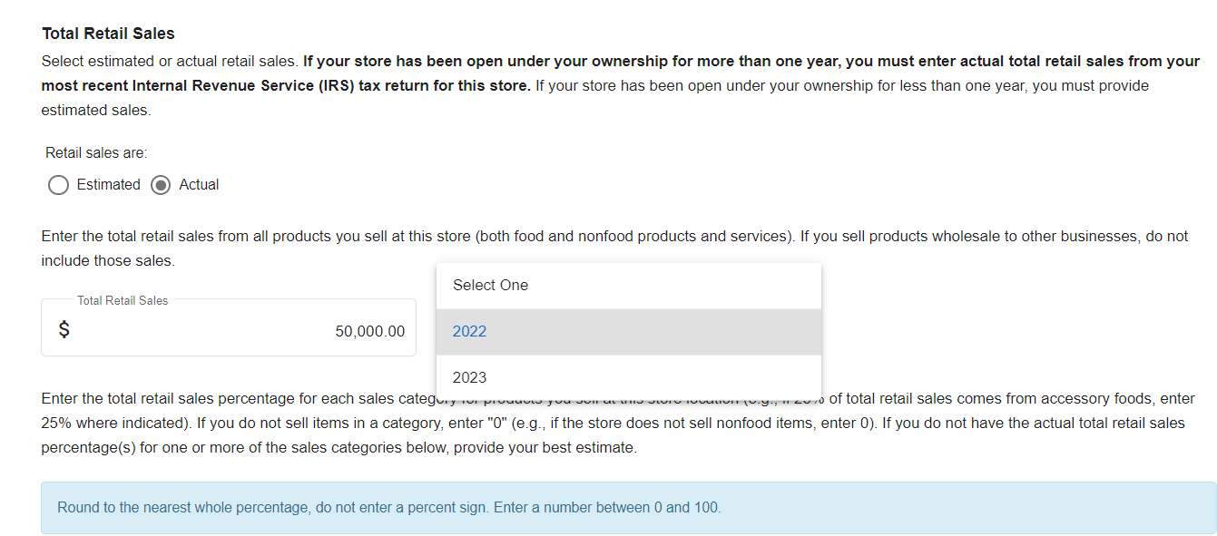

Slide 36
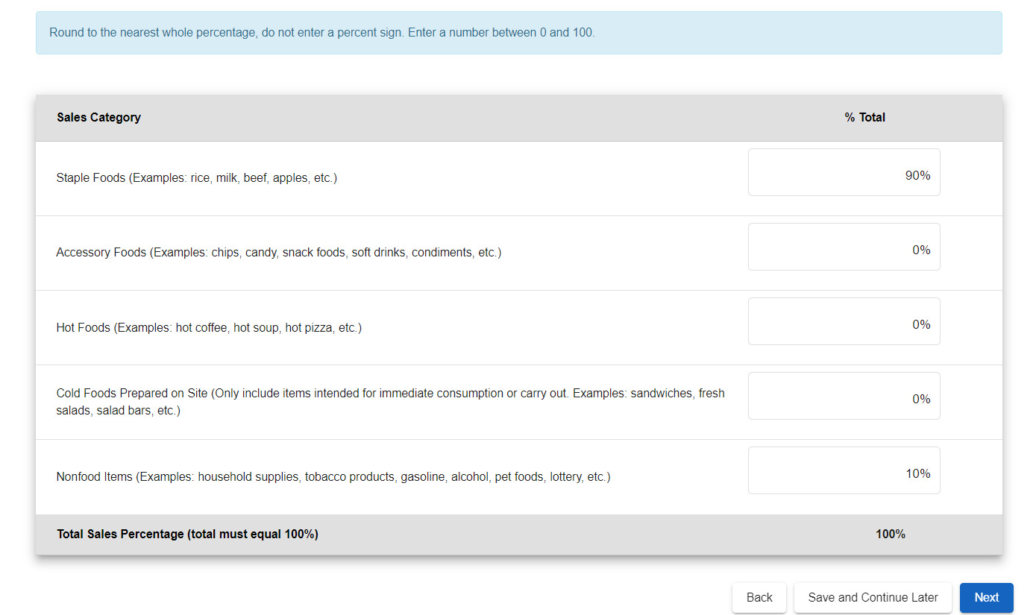

Slide 37
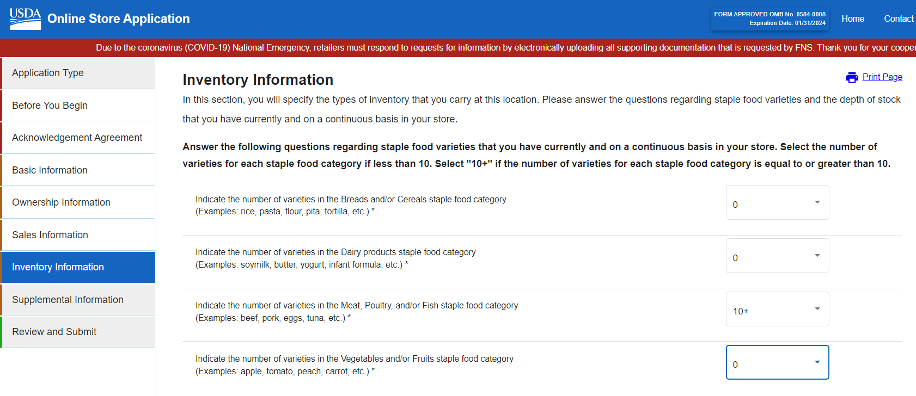

Slide 38
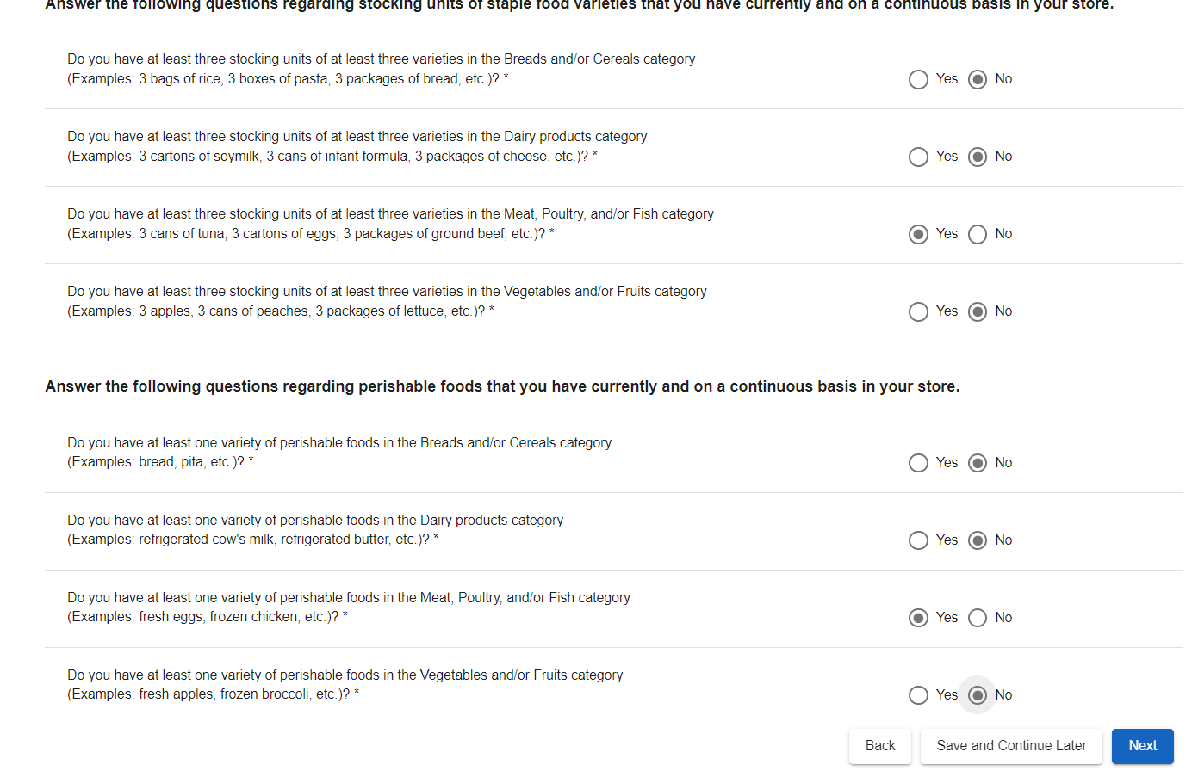

Slide 39
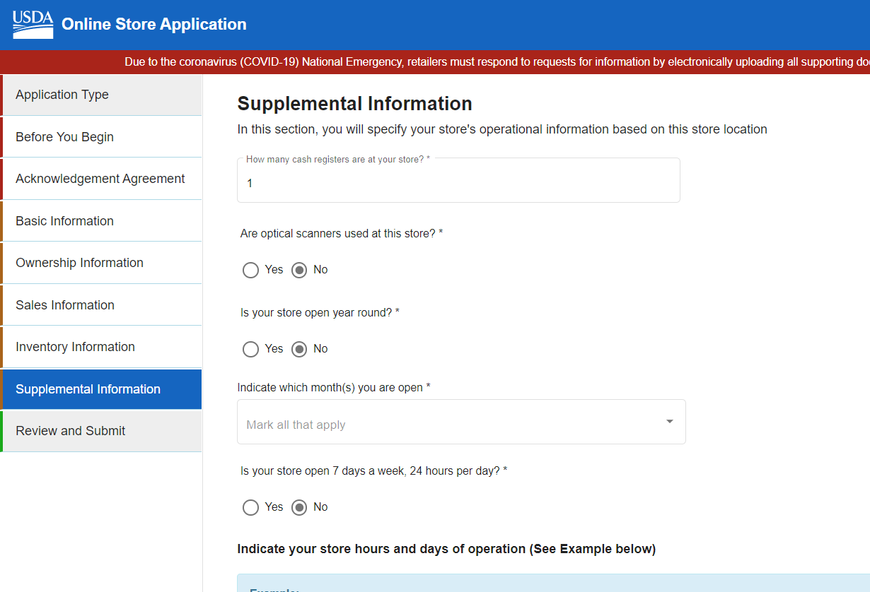
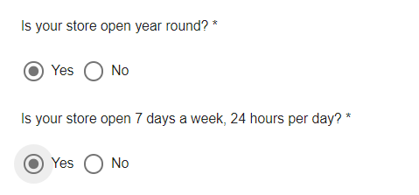

Slide 40
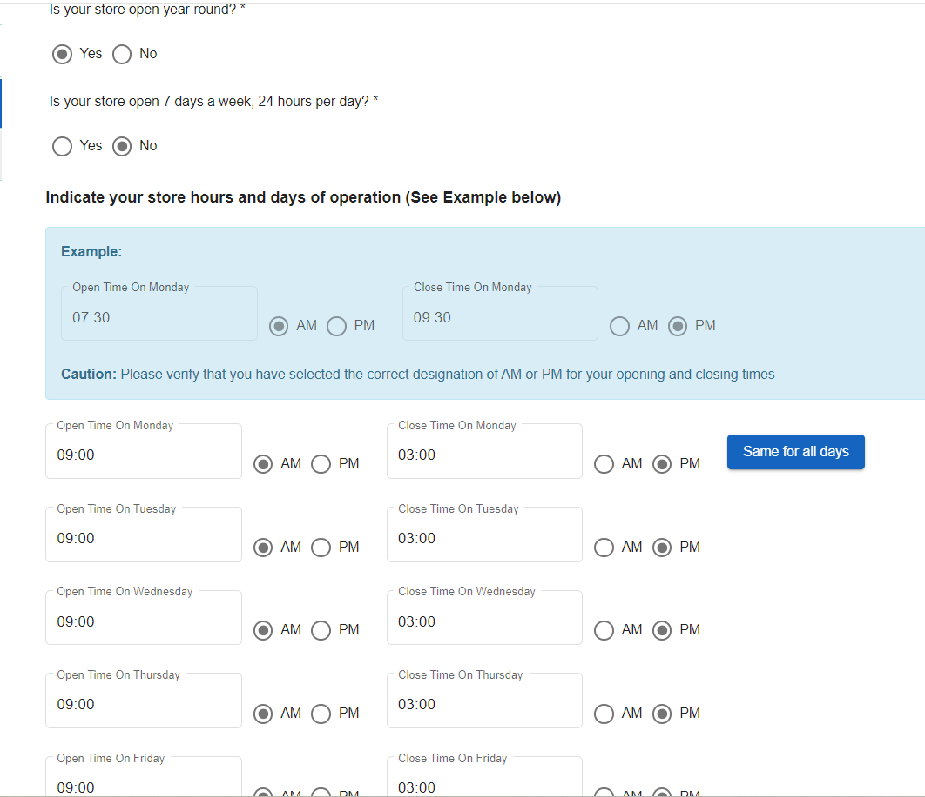

Slide 41
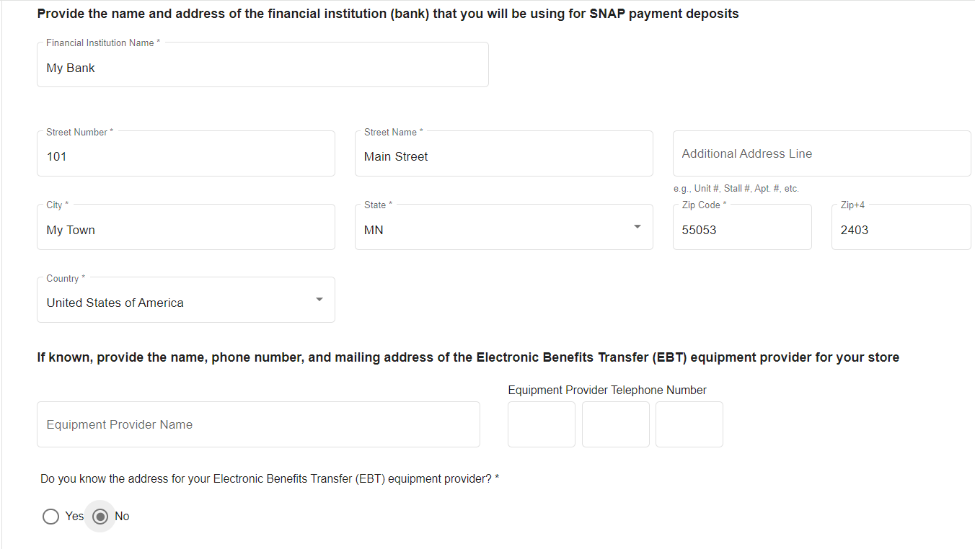

Slide 42
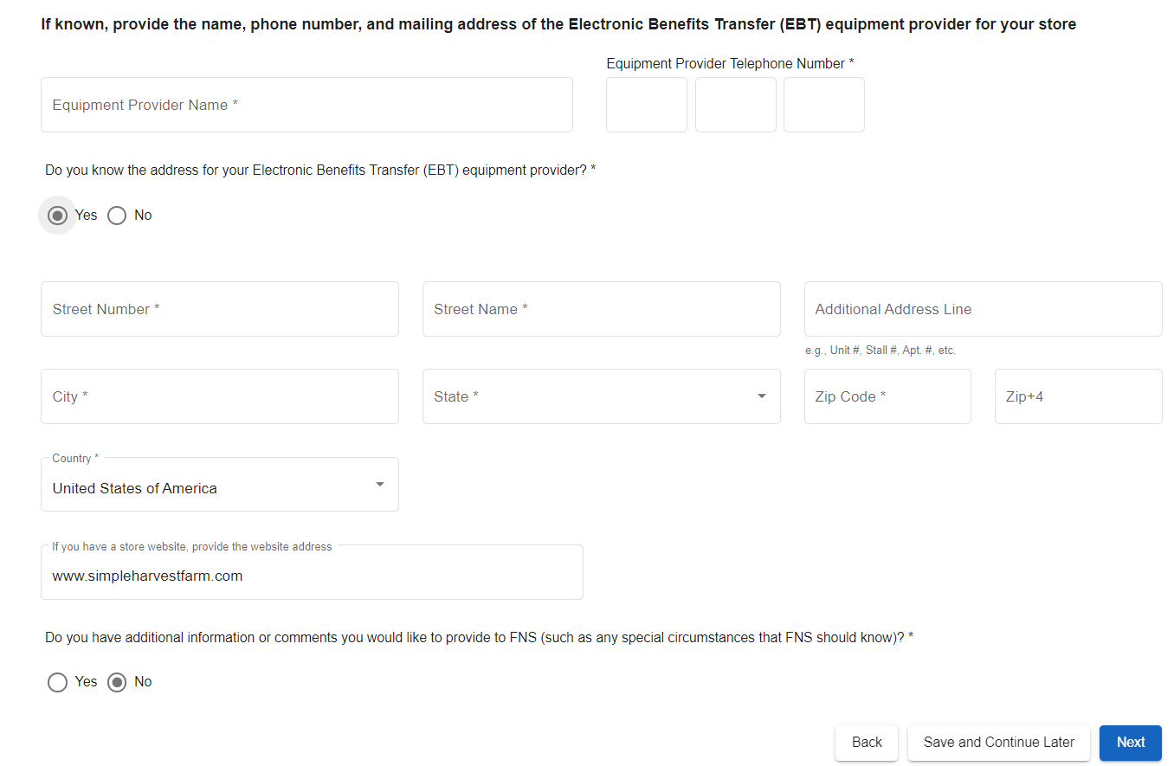

Slide 43
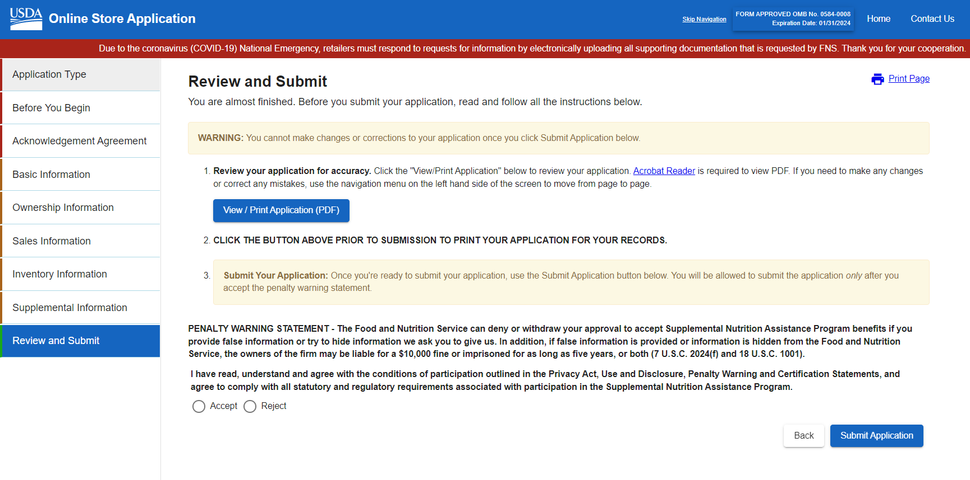

Slide 44
Scan your driver’s license and save the file as Your-Name-Drivers-License
Scan your social security card and save the file as Your-Name-SSN-Card
Scan a Business License card and save as Your-Name-Business-License
Upload each file 1-by-1 on the next screen
FNS sends you an email to confirm application
Email Jill Westfall at HSM to let her know you applied and would like to participate in Market Bucks in 2024
FNS will email you with questions if needed or
Emails you with a success message and you FNS Number!

Slide 45
Jill Westfall jwestfall@hungersolutions.org

Slide 46
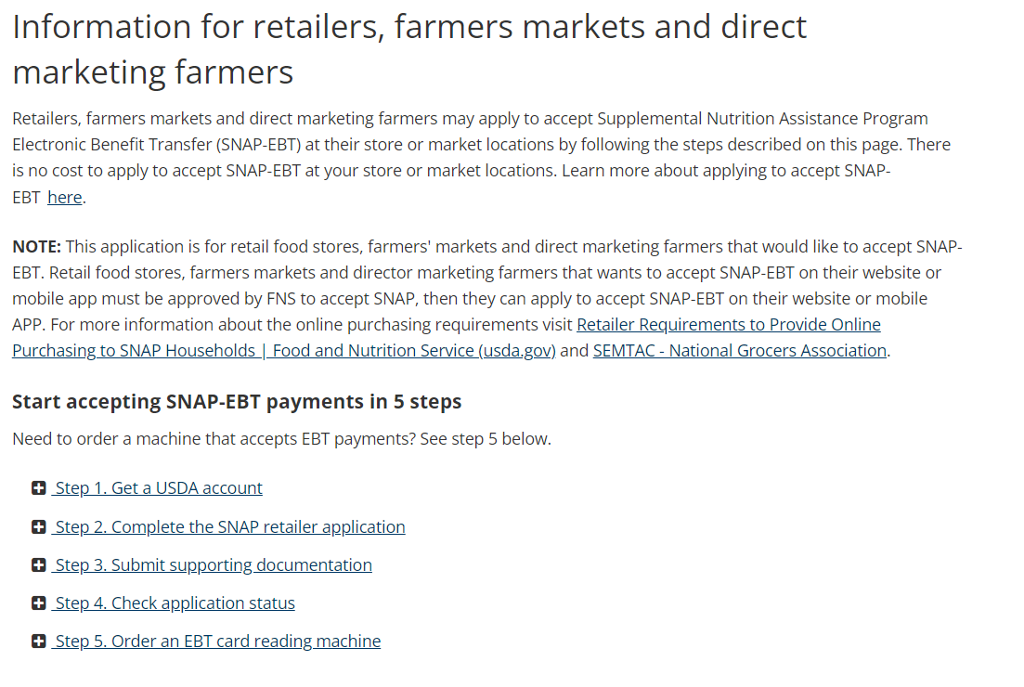

Slide 47
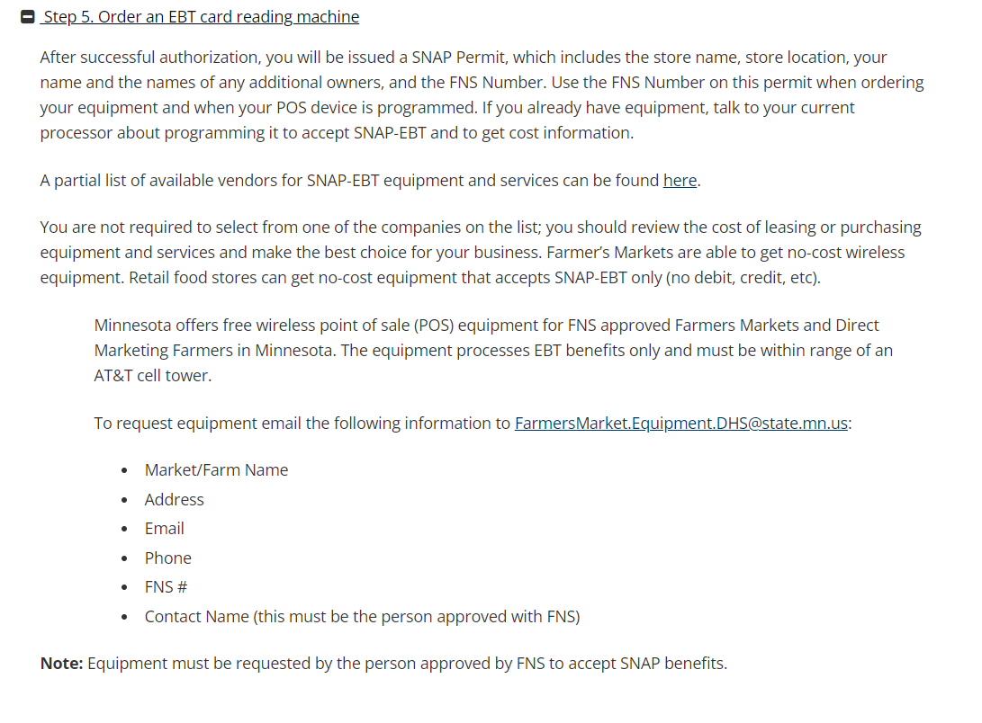

Slide 48
MN DHS connects you with FIS to get your free card reader machine & contract to pay for all transactions.
FIS will work with you to get your card reader machine operational.
Meanwhile – study the requirements for you to accept SNAP:
https://www.fns.usda.gov/snap/eligible-food-items

Slide 49
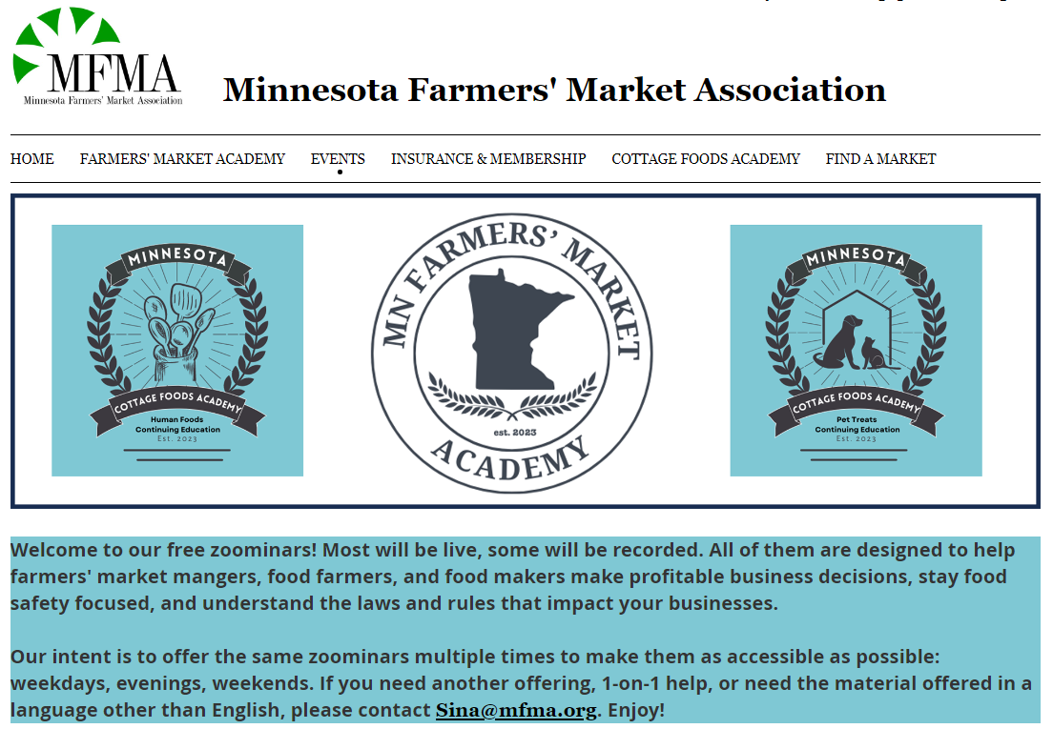
Need help? Join one of our zoominars. https://mfma.org/Events/

Slide 50
